Slide 1
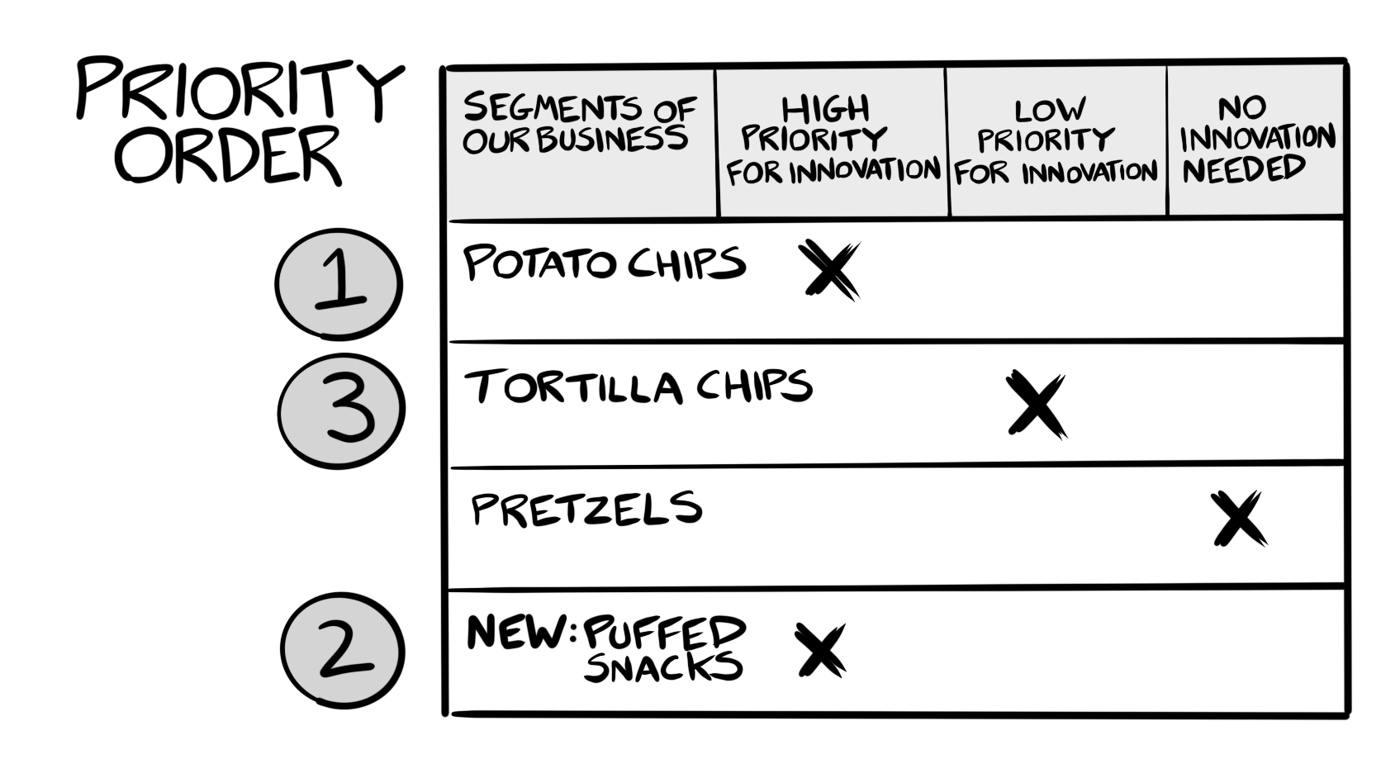

Example
Copyright Innovation Is Ugly LLC

Slide 2
Check the Appropriate Column
Innovation Focus Areas
Priority Order (fill in last) | Segments of Our Business | High Priority for Innovation | Low Priority for Innovation | No Innovation Needed

