Slide 1
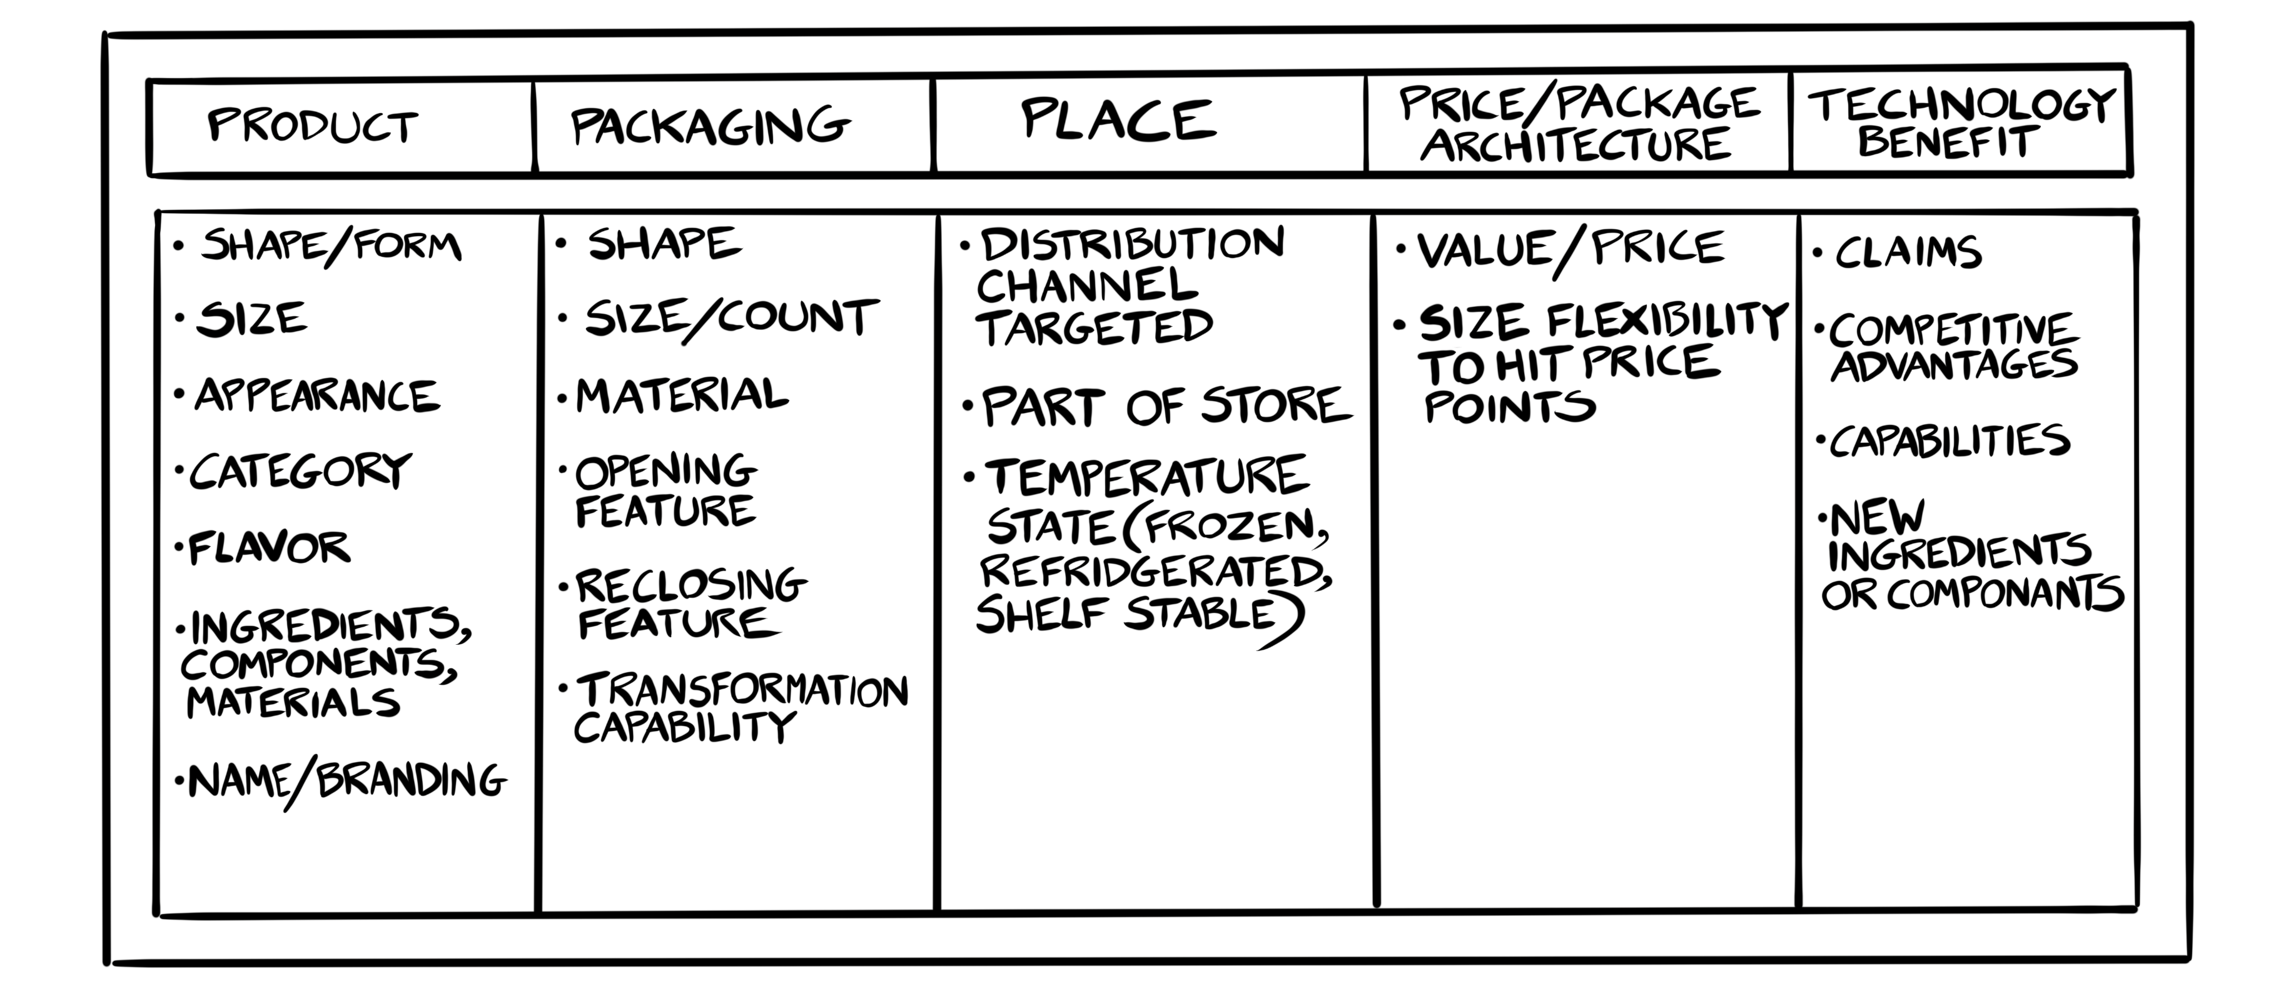

Guardrails to Consider
Copyright Innovation Is Ugly LLC

Slide 2
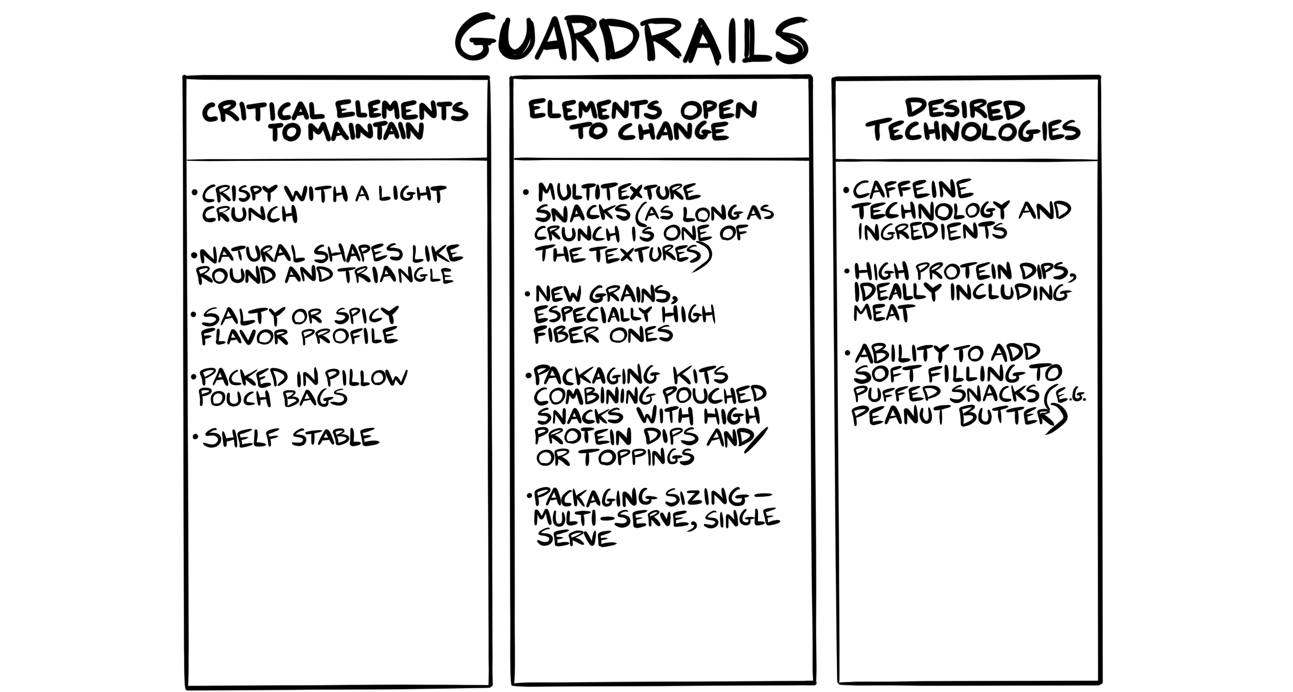
Example
Copyright Innovation Is Ugly LLC

Slide 3
Guardrails
CRITICAL ELEMENTS TO MAINTAIN | ELEMENTS OPEN TO CHANGE | DESIRED TECHNOLOGIES

