Slide 1
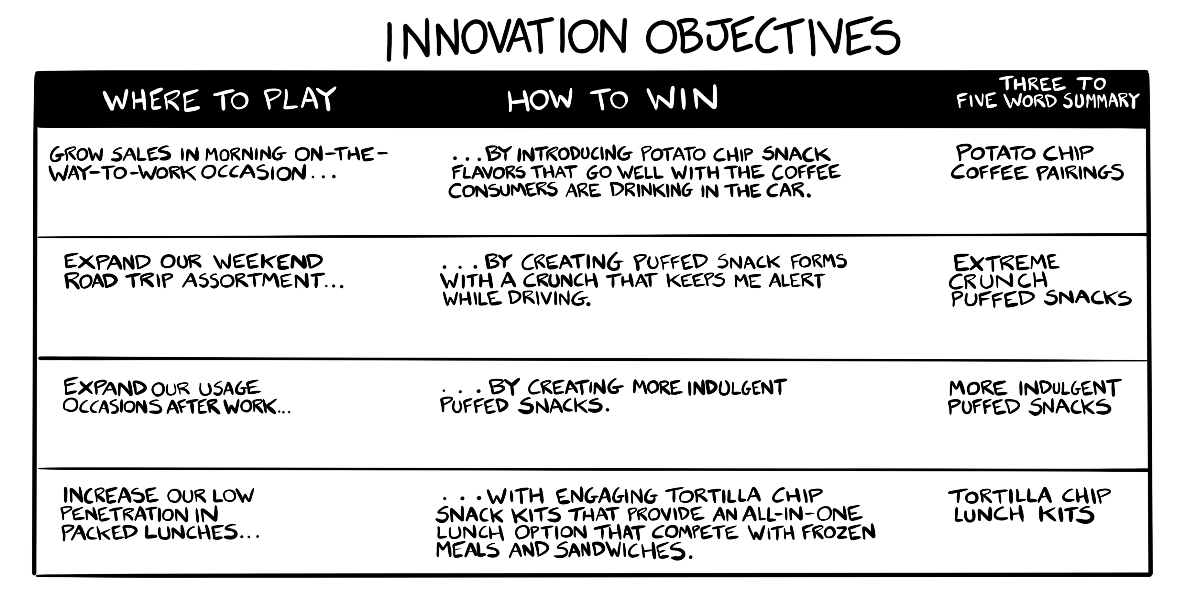

Example
Copyright Innovation Is Ugly LLC

Slide 2
Innovation Objectives
WHERE TO PLAY | HOW TO WIN | THREE TO FIVE WORD SUMMARY

