Slide 1
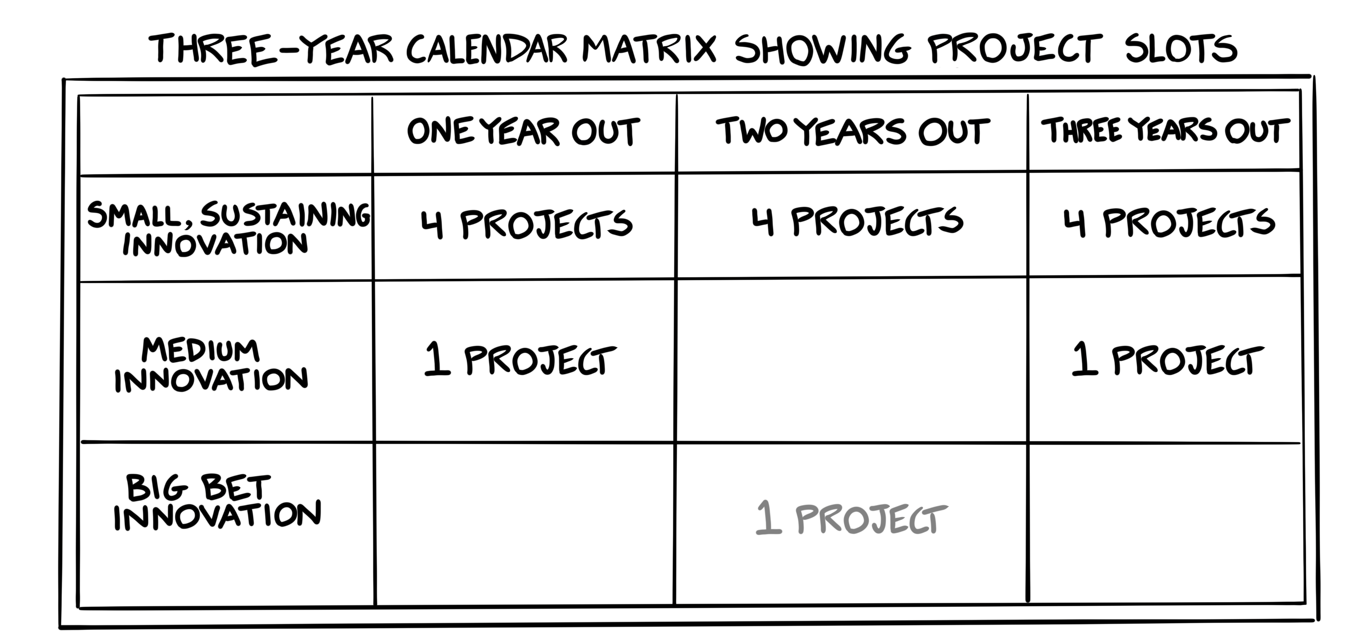

Copyright Innovation Is Ugly LLC

Slide 2
3 Year Innovation Pacing Calendar
You can use this to outline the number of slots you need, and to fill in the specific slots you want to develop.

